Slide 1
High performance scientific computing
INFO0939-1
Yaman Altaha

Slide 2
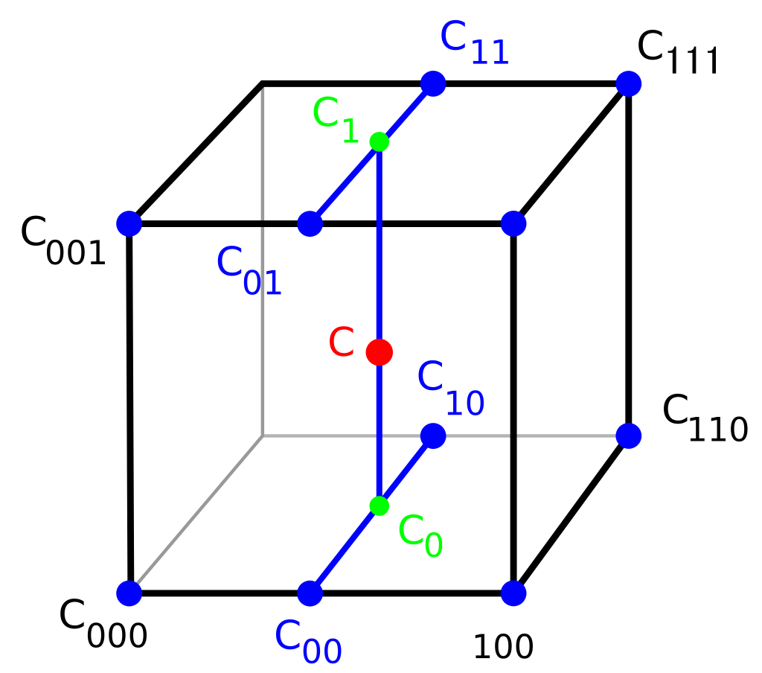
Trilinear Interpolation
Compute sound speed (c) and density (ρ) at any point in the 3D grid.
lattice_below: Finds nearest grid point below target (c000, ρ000).
Upper grid point (c111, ρ111) derived by incrementing indices.
xd, yd, zd: Measure how close the target point is to each grid boundary.
Interpolate c and ρ using values from 8 surrounding points:
c = (1 - zd) * ((1 - yd) * ((1 - xd) * c000 + xd * c100) + ...)
Image source: “https://en.wikipedia.org/wiki/Trilinear_interpolation#/media/File:3D_interpolation2.svg”
2

Slide 3
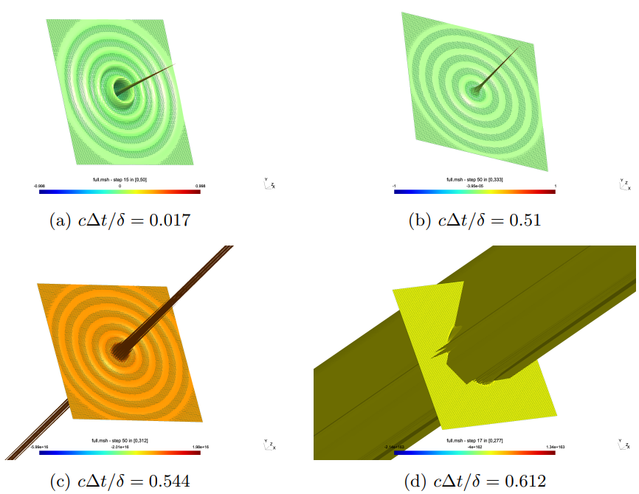
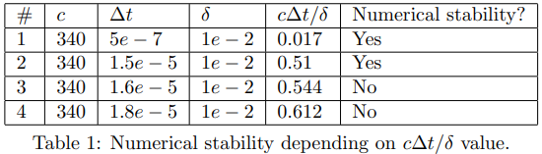
Stability Test
Stability tested by varying time step (Δt).
Kept speed of sound (c = 340 m/s) and grid spacing (δ = 1 × 10⁻² m) constant.
Found stability threshold at cΔt/δ ≈ 0.51; higher ratios cause instability.
Z-cut visualizations for the 4 experiments

Slide 4
CPU vs Memory Bound
Analysis of Arithmetic Intensity
init_simulation: Memory-heavy, not a bottleneck (runs once).
apply_source: Minimal memory access, CPU-intensive.
write_output: Memory-bound due to file I/O.
update_pressure: CPU-bound but memory access still significant (10 FLOPs vs. 10 memory accesses).
update_velocities: Similar to pressure update, more CPU-bound but memory access still relevant.
The program is memory-bound.

Slide 5
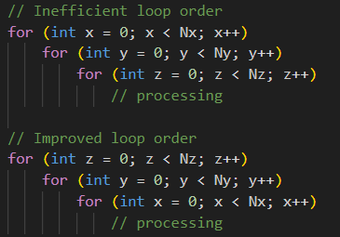
CPU Cache Bottlenecks
Issue: Initial loop order (x, y, z) caused poor cache usage and frequent cache misses.
Fix: Reordered loops to (z, y, x) to improve spatial locality and access contiguous memory locations consecutively.
Result: Improved overall performance by reducing cache bottlenecks.
Loop Order Improvement
5

Slide 6
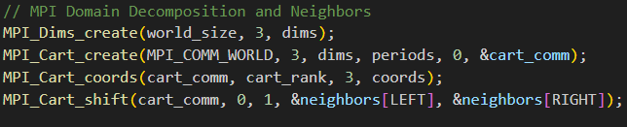
MPI-Based Domain Decomposition
Domain Partitioning
Neighbour Communication
Domain split across MPI processes using a 3D Cartesian grid (MPI_Dims_create).
Each process handles a subdomain defined by grid coordinates coords[] and dimensions dims[].
Variables (start_x, end_x, etc.) define subdomain boundaries within the global grid.
Boundary data exchanged using non-blocking MPI calls (MPI_Isend, MPI_Irecv).
allocate_comm_buffers prepares buffers for boundary data transfer.
update_pressure and update_velocities integrate boundary data independently.
MPI 3D Grid Decomposition and Communication
6

Slide 7
MPI-Parallel Execution and Synchronization
Local Computation:
Each process updates pressure and velocity fields within its subdomain using update_inner_pressure and update_inner_velocities.
Synchronization:
Boundary data synchronised via MPI_Waitall ensures consistency across subdomains.
The root process (cart_rank == root) gathers results from all processes using MPI_Gatherv.

Slide 8
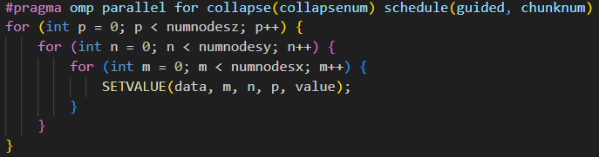
OpenMP - Loop Parallelization
Efficiently distributes workload across threads in critical loops.
The collapse merged nested loops to improve parallel execution.
Guided scheduling ensures dynamic workload balancing across threads.
Result:
Achieved significant speedup and scalability, allowing for faster simulations on multi-core CPUs.
Optimised Parallel Loop with OpenMP
8

Slide 9
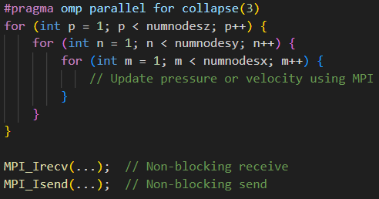
Hybrid MPI + OpenMP Integration
Hybrid Parallelism:
MPI: Manages communication between processes to synchronize boundary data.
OpenMP: Accelerates computation within each MPI process using parallel nested loops.
Result:
Hybrid approach leverages both distributed (MPI) and shared (OpenMP) memory parallelism, improving overall performance.
Hybrid Parallelism Example
9

Slide 10
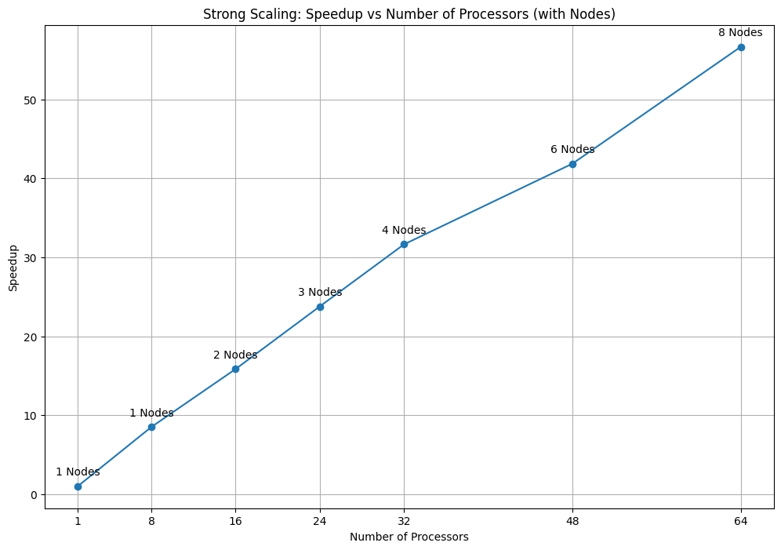
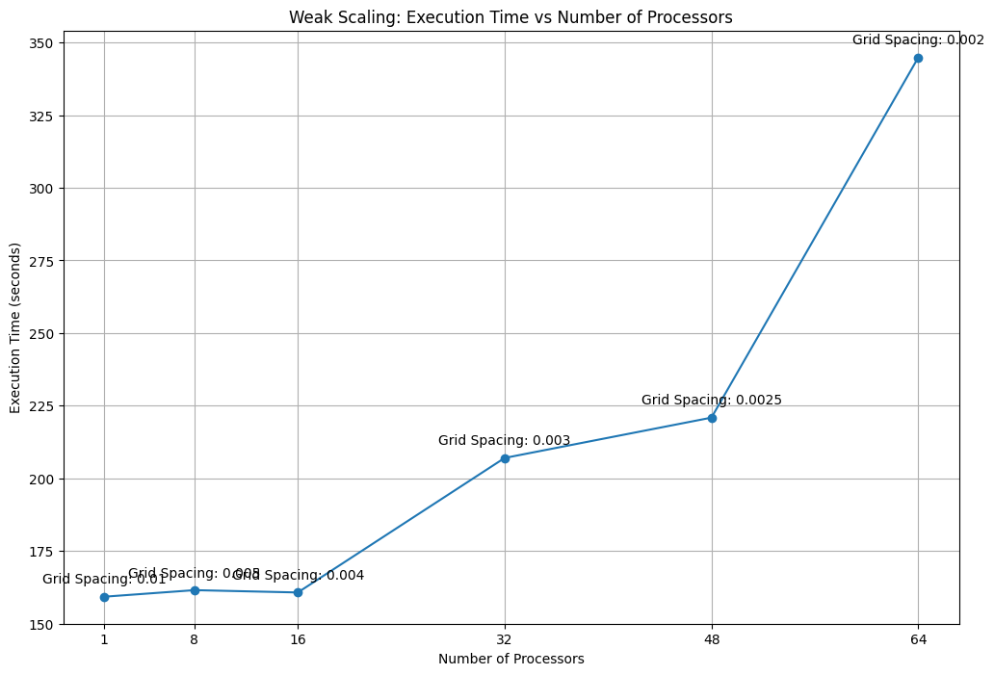
Strong - Weak scaling MPI
Strong:
Speedup increases with processor count, showing successful parallelisation.
Decreasing returns observed with more processors due to synchronisation costs.
Node distribution annotated, highlighting hardware scalability.
Weak:
Execution time remains stable with fewer processors
Time increases with more processors due to communication overhead.
Grid spacing annotations show how problem size scales with processor count.
10

Slide 11
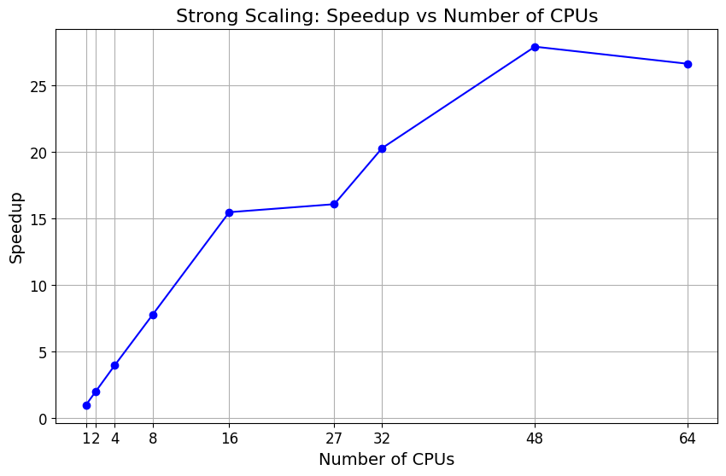
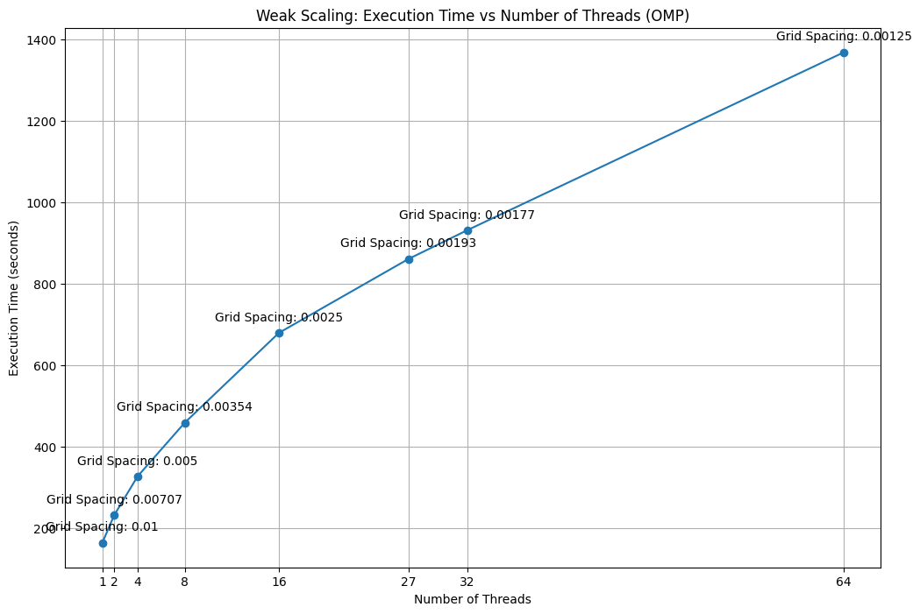
Strong - Weak Scaling OMP
Strong (With LIKWID):
Low CPI (~0.35) indicates powerful processing in loops.
Low cache miss ratio (~0.0034) shows efficient memory access benefiting contiguous data use.
Weak:
Execution time increases with more threads, showing weak scaling challenges.
Finer grid spacings lead to longer runtimes.
Significant time increase at higher threads counts suggests overhead issues.
11

Slide 12
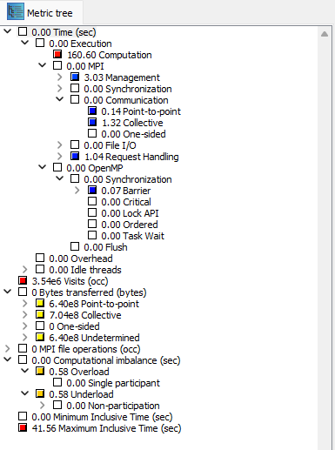
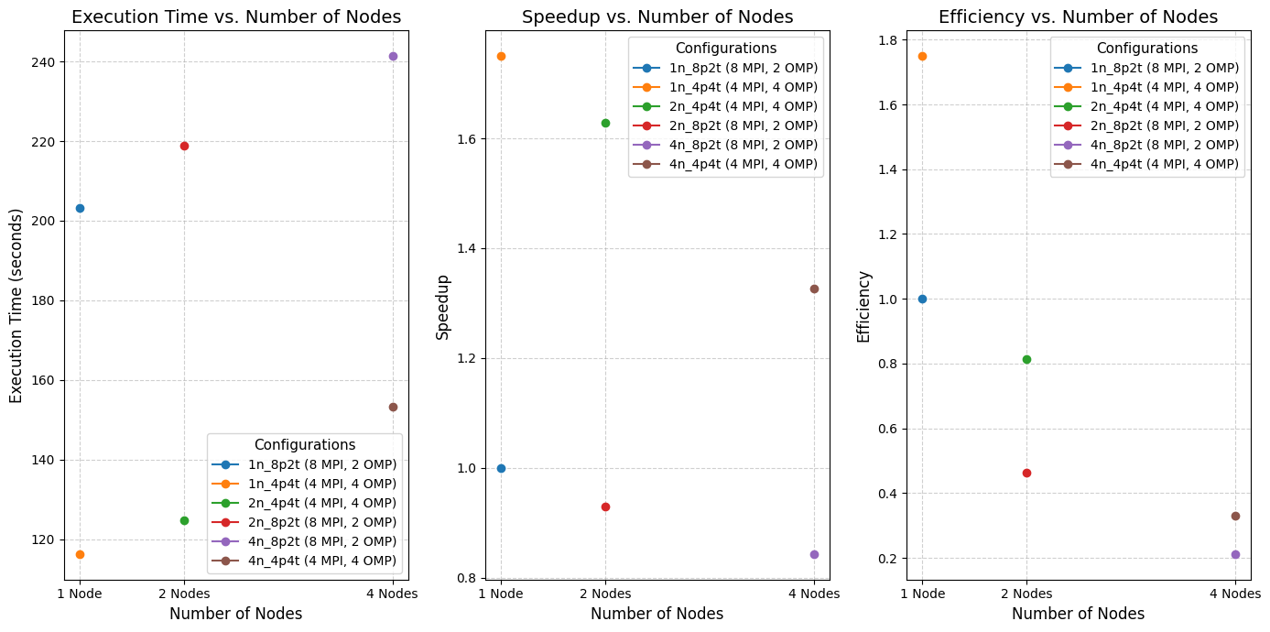
Strong - Weak: Scaling Hybrid MPI+OMP
Strong (With Score-P):
Execution Time: Decreases with more nodes, showing acceptable parallelisation in some configurations.
Speedup: Increases with more MPI processes and nodes, but not all configurations scale perfectly.
Efficiency: Decreases as nodes increase, highlighting overhead in hybrid parallelization.
MPI Overhead: Minimal MPI communication overhead noted (point-to-point and collective).
OpenMP Overhead: Slight overhead observed in Barrier synchronization.
12

Slide 13
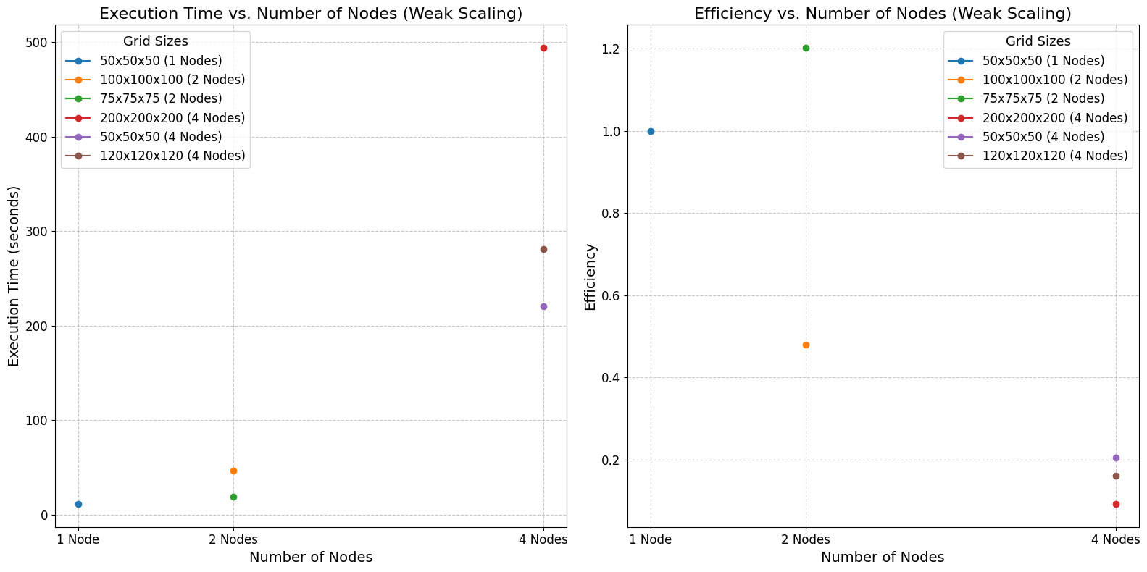
Strong - Weak: Scaling Hybrid MPI+OMP
Weak:
Execution time Increases with node count due to larger grids and higher computational demands.
Efficiency varies across different grid sizes, showing uneven workload distribution and communication challenges.
13

Slide 14
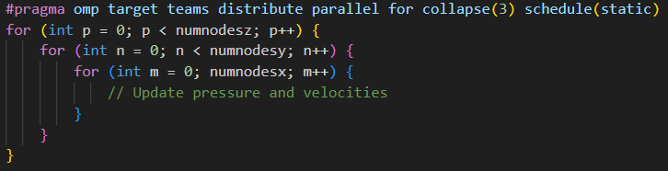
OpenMP - GPU Acceleration
Offloads computation to GPU.
Maps simulation data to GPU memory for smooth CPU-GPU communication.
Parallelises nested loops for pressure and velocity updates across GPU threads.
Result:
GPU-accelerated version reduces simulation time compared to CPU-only execution.
GPU Loop Parallelization
14

Slide 15
Thanks for Listening

